Slide 1
Food Vlogs Webpage using HTML and CSS(Basic)
-By Joy deb

Slide 2
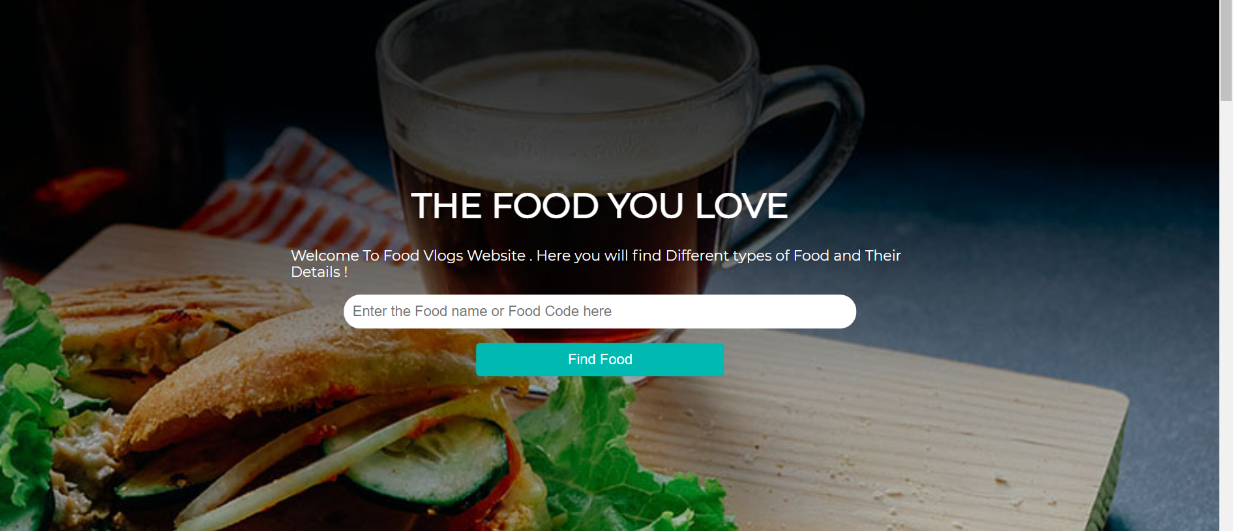
1.
Introduction about the webpages and their is search box tool where you can find the food using food name and food code

Slide 3
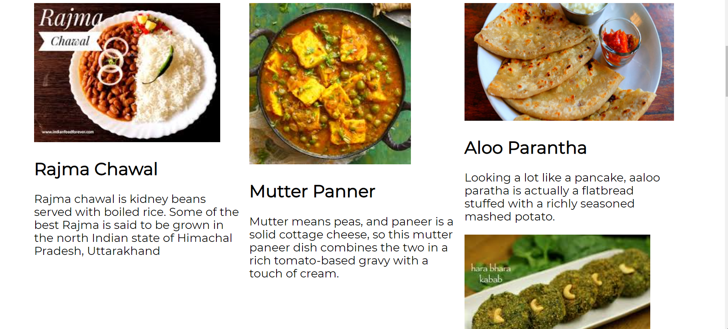
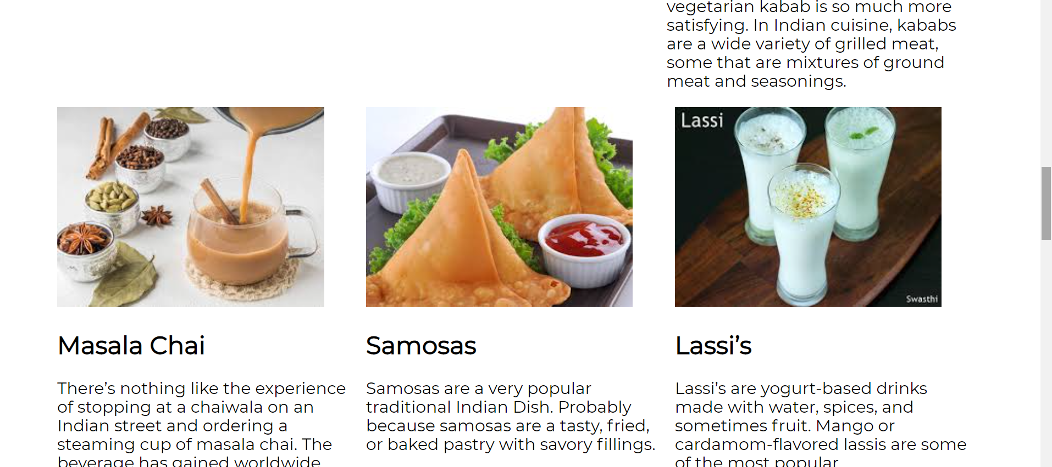
2.
Here you will find some food items name and their desciption which are made in row and column with sample photo attacted with them

Slide 4
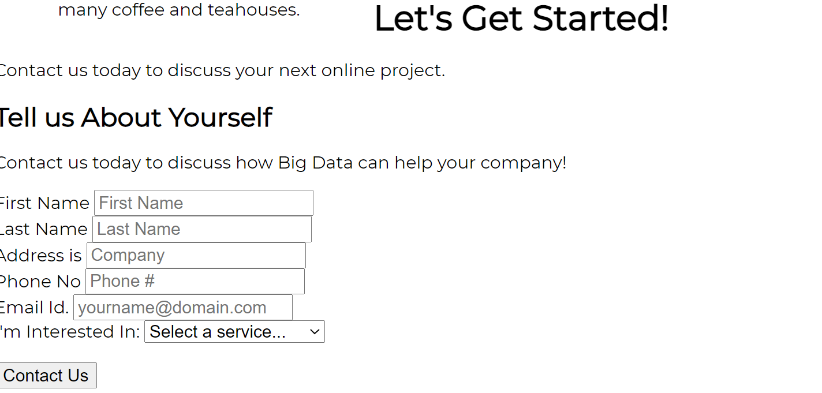
3.
About us section and Tell me about your self section where First name , last name, address,Phone number and Email and their is a box where you can choose the option you are interested and Contact Us Button

Slide 5
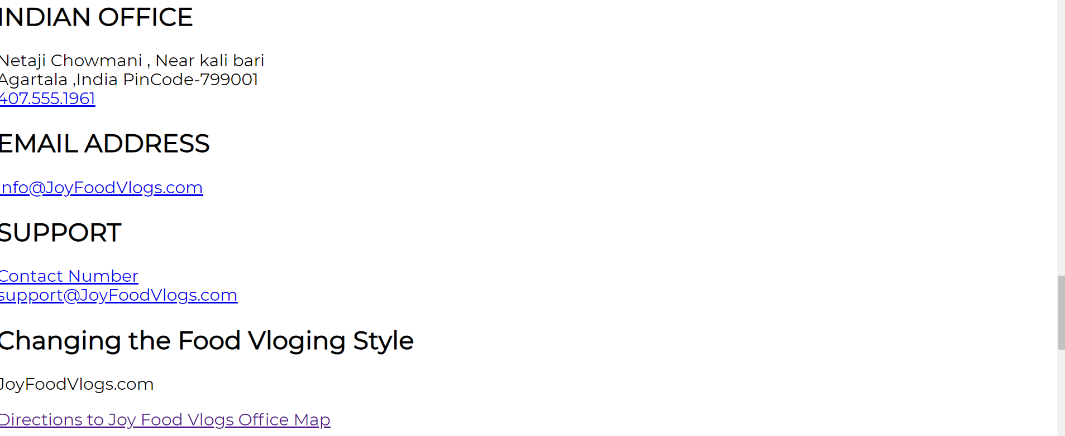
4.
Their is a Indian Office Address with Map Location , Email Address section ,Supprot Section and Last Webpage Company Tagline , Website and Direction to the Address of owner of this Website which is directed by Google Maps

Slide 6


